Slide 1
CAMPUS PLACEMENT DATA ANALYTICS

Slide 2
Presented By:
PRABUDH KUMAR | (20103246)
KRITANK RISHI GOYAL | (20103252)
NEHAL JAIN | (20103249)
Presented To:
Under Supervision Of:
DR. GAZALA YASHMIN
DR. HEMA N.
DR. NEETU SARADANA

Slide 3
BACKGROUND
Initiation: Focused on DBMS, OS, and Networking for technical interview questions.
Analysis Techniques: Applied BERT, LDA, and GSDMM for unsupervised analysis of theoretical questions.
Clustering: Grouped questions into potential topics for pattern identification.
Coherence Evaluation: Ensured topic quality through coherence evaluation.
BERTopic Integration: Incorporated BERTopic for predicting aligned topics visually.
Extension Strategies: Improved predictive accuracy through n-gram analysis and data enrichment.

Slide 4
Problem Statement
Now, we want to further extend our project and tackle remaining problems, so that, we can make the analysis obtained from our research to actual usage.
OBJECTIVES:
Mapping of buckets obtained from our model to actual taught topics for better understanding to users.
Streamlining the entire process by consolidating disparate steps into a cohesive and efficient workflow.
Providing a dashboard for users to use our model for their set of questions and obtaining meaningful insights from our analysis.

Slide 5
Proposed Methodology

Slide 6
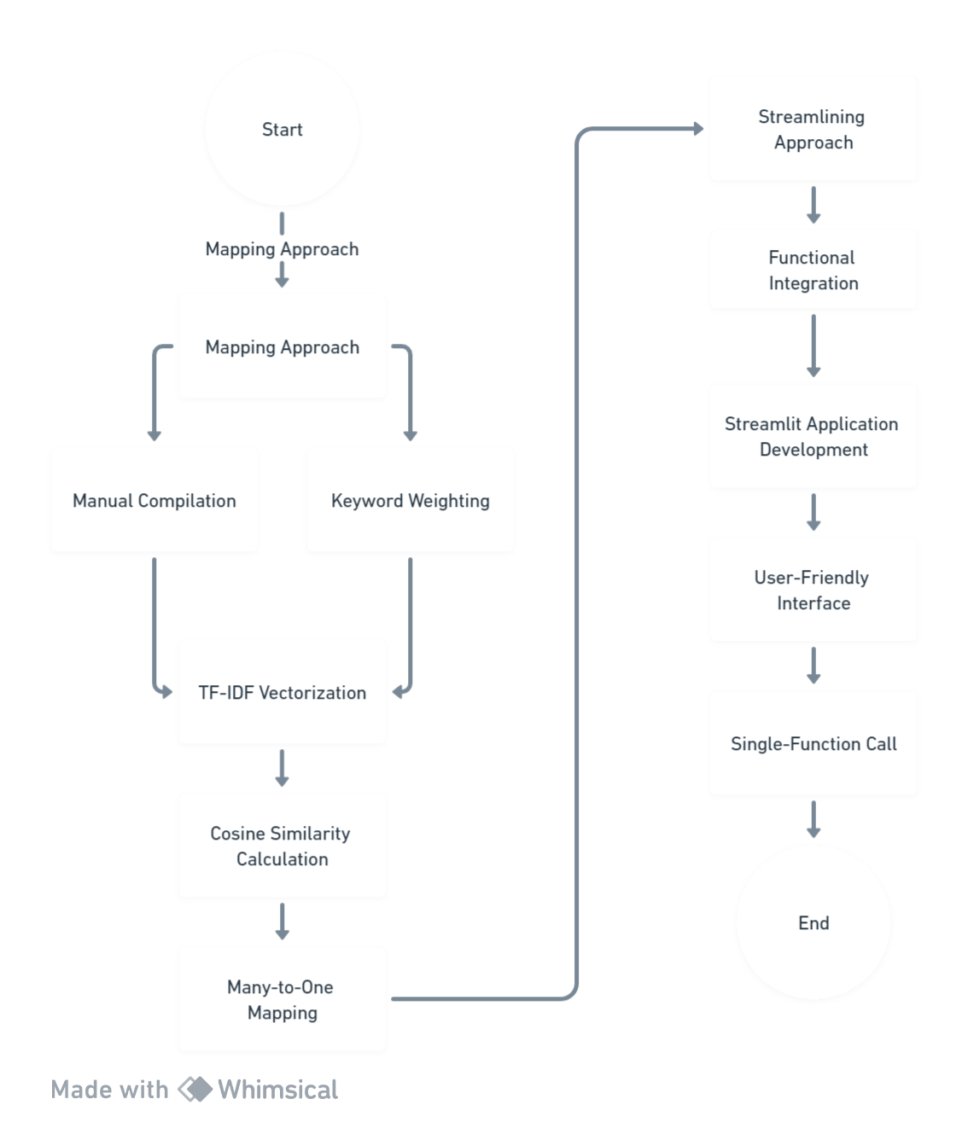

Slide 7
Tech Stack
Language Used:
Python 3
Libraries to be Used:
streamlit
pandas
os
docx
BERTopic
nltk
gensim
matplotlib
Pillow (PIL)
TfidfVectorizer

Slide 8
Theory of approaches

Slide 9
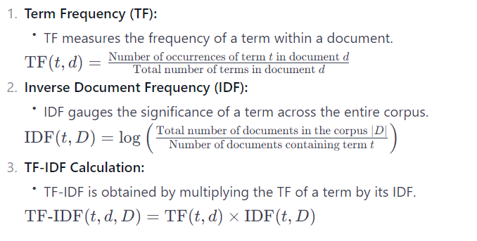
TF-IDF Vectorization Term Frequency-Inverse Document Frequency (TF-IDF) vectorization is a pivotal technique in natural language processing, offering a numerical representation of text data while emphasizing the importance of individual terms. This method proves instrumental in various applications, such as information retrieval, document clustering, and topic modeling.
Formulas:

Slide 10
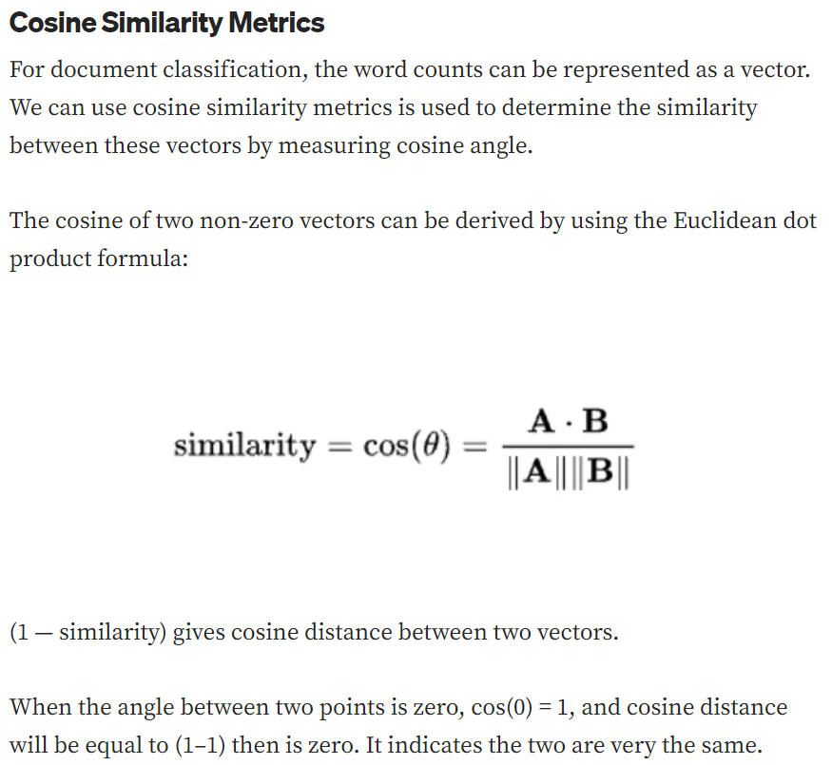

Slide 11

Streamlit Overview:
Streamlit is a Python library that simplifies the creation of interactive web applications for data science and machine learning. It allows developers to transform data scripts into shareable web apps with minimal effort. By providing an easy-to-use interface, Streamlit enables quick and efficient development, making it accessible for both beginners and experienced developers. The framework supports real-time interaction, making it suitable for tasks like data visualization, model prototyping, and analytics dashboards. With its simplicity and versatility, Streamlit has gained popularity in the data science community for its ability to turn complex data projects into interactive applications seamlessly.

Slide 12
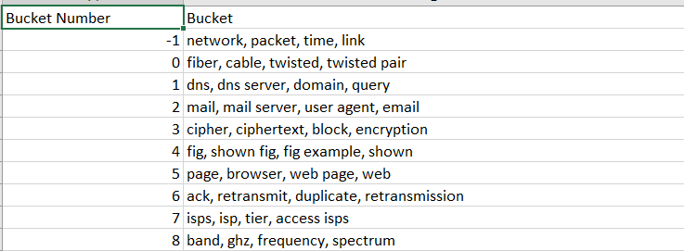
Mapping
What we have?
The BERTopic model generates multiple buckets, each representing a cluster of related questions based on their underlying topics.
Buckets of topics names matched with topic numbers predicted by our enhanced BERTopic model.

Slide 13
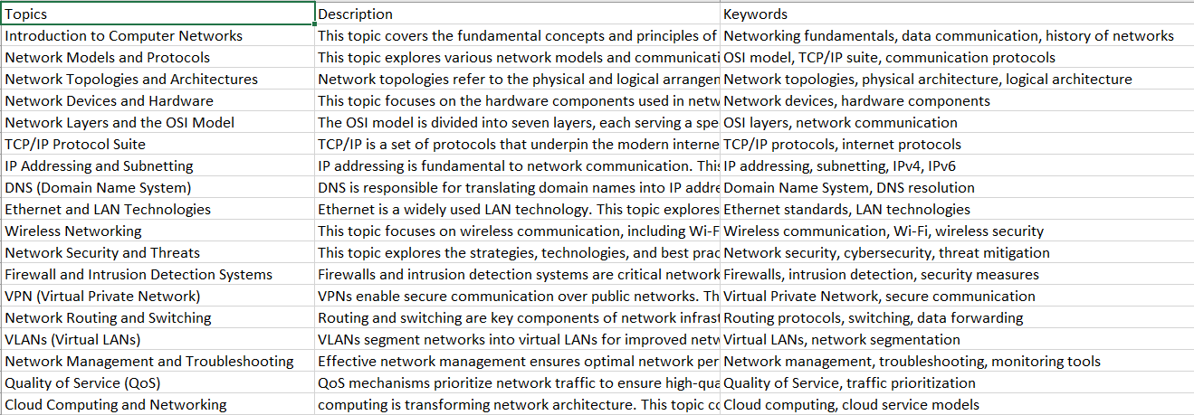
What we need?
However, in the context of mapping these buckets to the predefined curriculum topics, the relationship is many-to-one. This implies that several buckets may be associated with, or mapped to, a single curriculum topic.
For this, we manually generated a list of topics for each subject of OS, DBMS and Networking taught in our campus. Along with this we needed to feed the context of these topics to present the topic in vectorized form. Hence, we generated a .csv file which consisted of Topic, Description and main Keywords associated with each topic.

Slide 14
Assigned greater importance to keywords within our text data and combine them with the description. This ensured that critical terms play a more prominent role in similarity calculations, potentially leading to more accurate mappings.
Utilized TF-IDF (Term Frequency-Inverse Document Frequency) vectorization to transform text data into numerical vectors
Computed cosine similarity between the TF-IDF vectors of predicted buckets and topics.
For each bucket, topic with maximum similarity was matched.
Hence, we obtained one to one mappings of each buckets with its topic.
At last, we were able to assign the most similar topic to each question of dataset.

Slide 15
Streamlining the project
Libraries Used:
Import necessary libraries for the application, such as os, gensim, WordNetLemmatizer, pandas, BERTopic, streamlit, and PIL.
Text Preprocessing Functions:
Define two text preprocessing functions:
ls(text): Lemmatizes the input text using WordNetLemmatizer.
pp(text): Preprocesses the text by tokenizing, removing stopwords, and lemmatizing.
Data Loading and Preprocessing:
Define a function get_ques_list(folder) to load and preprocess questions from .docx files in the specified folder.
Organize questions by the company name.
BERTopic Model Loading:
Load the BERTopic model using BERTopic.load(model_path).

Slide 16
5. Mapping and Topic Assignment:
For each question, identify similar topics using the BERTopic model.
Establish a mapping between BERTopic buckets and book topics based on cosine similarity scores.
6. Results Storage:
Store results in dictionaries (all_topics_per_company and all_results_table) for each company.
These dictionaries store information about each question, its similar topics, and the mapped book topics.
7. Streamlit UI Setup:
Set up the Streamlit app with a title and sidebar for navigation.
Include a text input box for the user to enter the path to the folder containing .docx files.
Add a sidebar with options to switch between "Data Table" and "Images" views.

Slide 17
Dashboard
User Input: Accepts user input for the folder path containing '.docx' files, allowing users to specify the data source.
Navigation Sidebar: Provides a sidebar for user navigation, enabling users to switch between different views, including a data table view and an image view.
Analysis Button (Analyze): Triggers the analysis process, executing the defined workflow.
Data Tables (Data Table View): Displays detailed information, including questions, corresponding topics, and book topics in a tabular format.
Images (Images View): Visualizes results through graphical images generated during the analysis process, providing a more intuitive representation of the data.

Slide 18
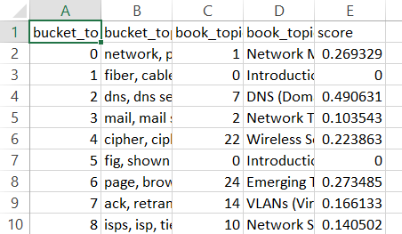
RESULTS Fig: CSV file of mapping of bucket topic to book topics

Slide 19
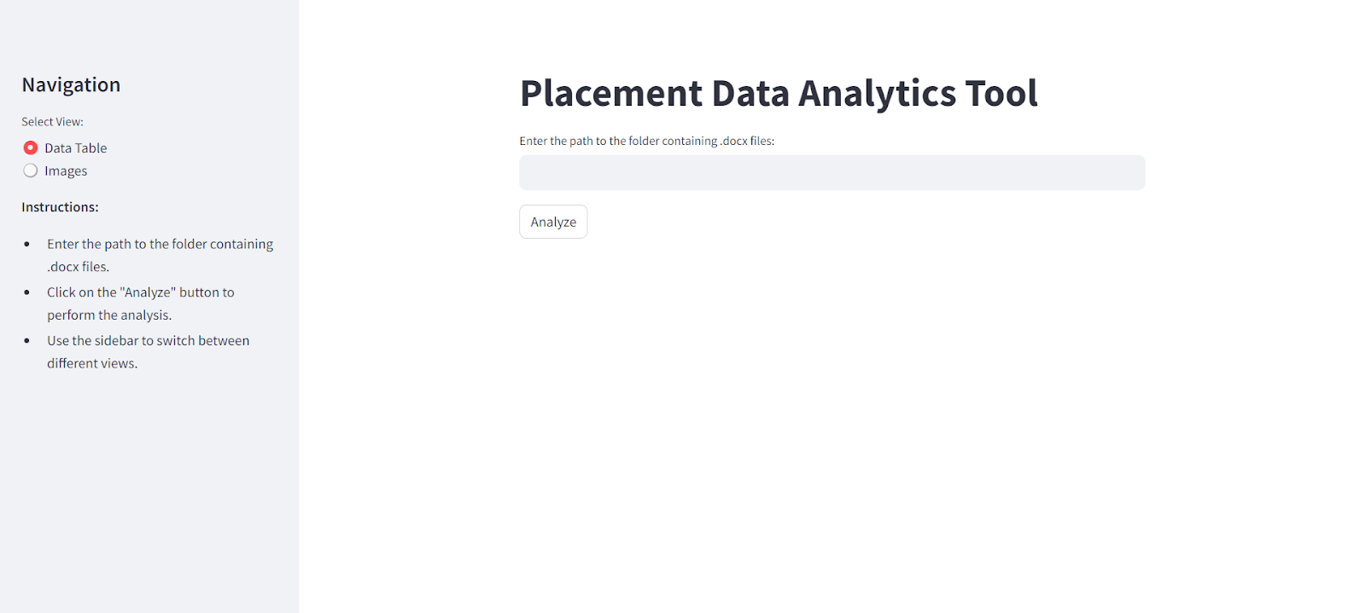
Fig: Streamlit application

Slide 20
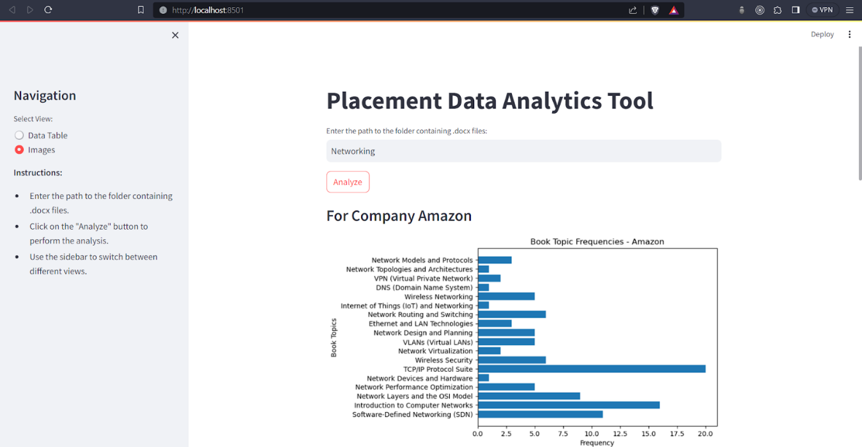
After mapping was completed , we visualized the graph for each company for each subject :

Slide 21
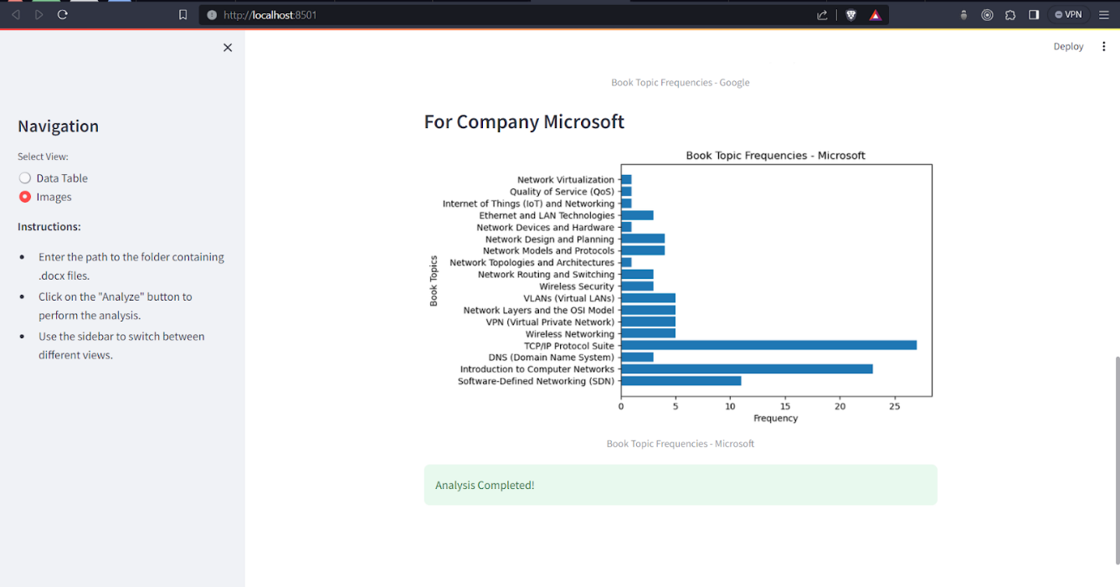

Slide 22
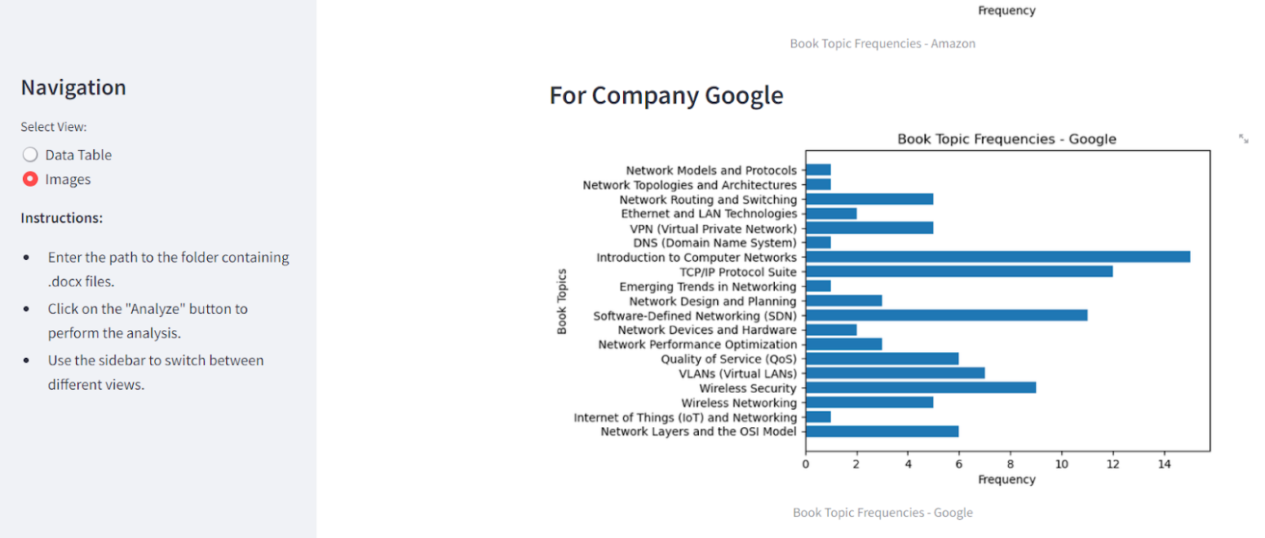

Slide 23
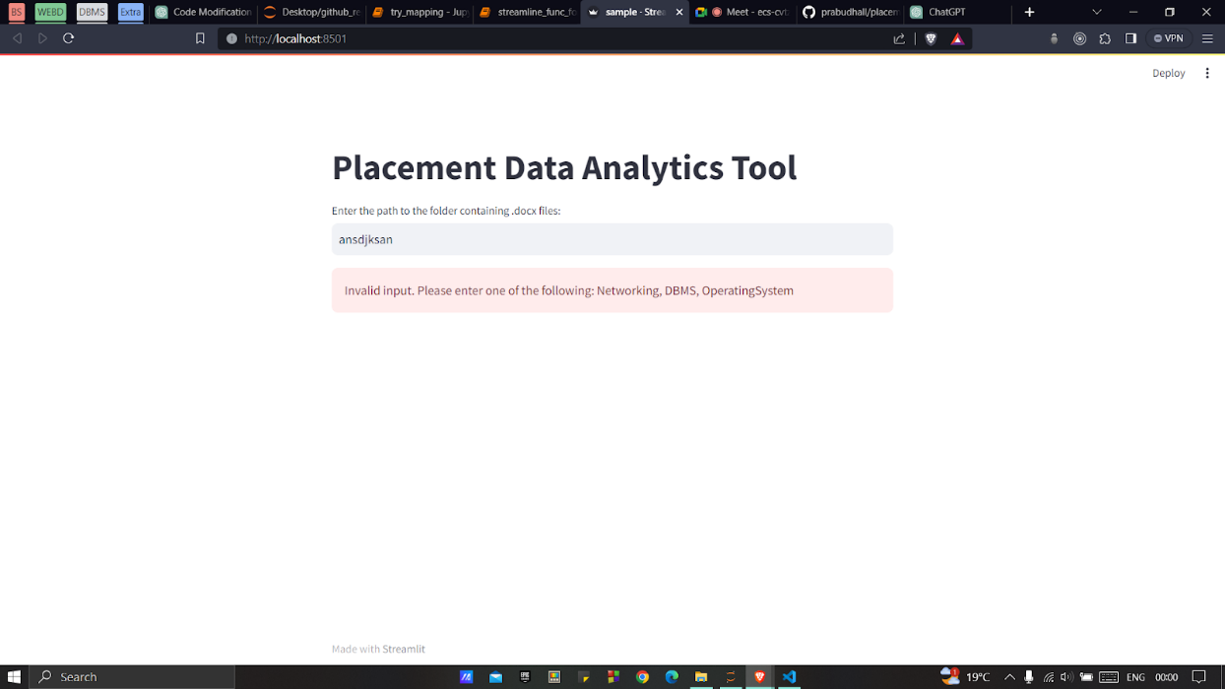
We finished our streamlit application where we can see :

Slide 24
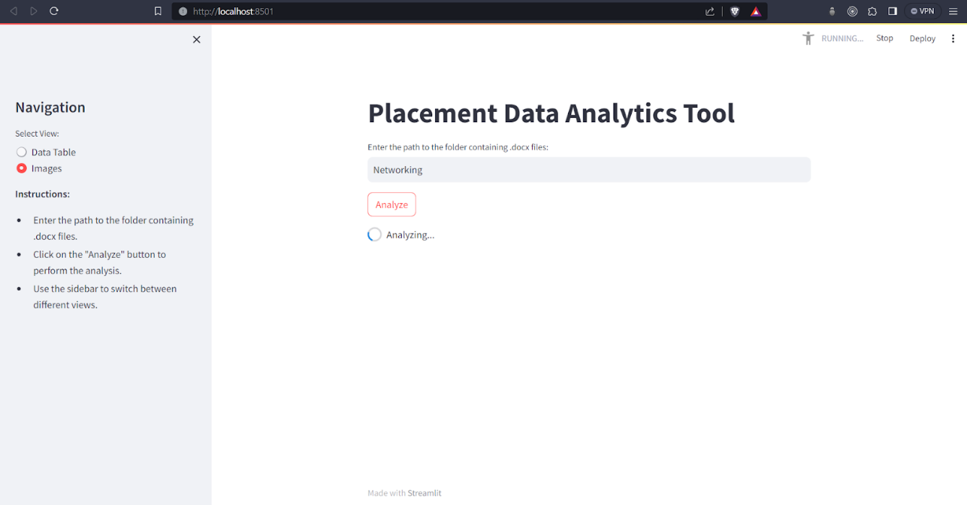

Slide 25
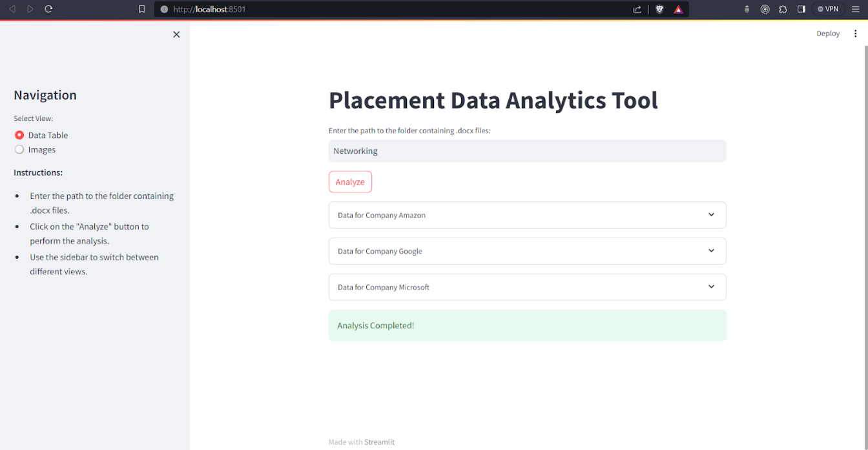

Slide 26
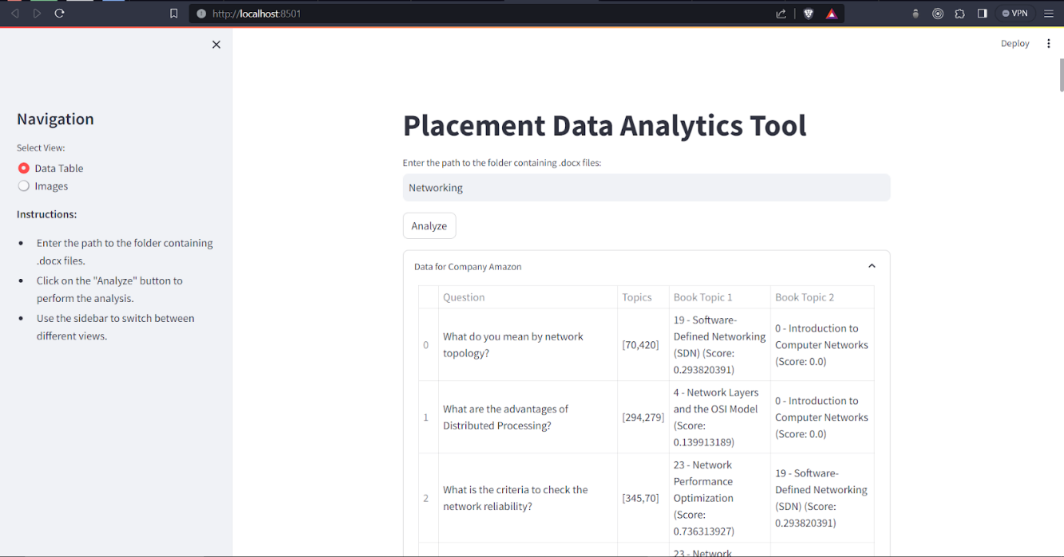

Slide 27
After analyzing the graph generated we could come up with topic having most importance for each company:
Subject | Amazon | Google | Microsoft
Networking | TCP/IP Protocol Suite | Introduction to Computer Networks | TCP/IP Protocol Suite
DBMS | 1.Database Design and Normalization 2.Introduction to Database Management System | Database Design and Normalization | Database Design and Normalization
Operating System | Distributed File Systems | Introduction to Operating System | Distributed Systems and Networking

Slide 28
THANK YOU

